Slide 1

Easy Housing Solutions (EHS)
.NET CORE AZURE SPRINT | Capgemini Case Study Implementation
Enterprise Level Property Management System

Slide 2


PROJECT TEAM
Divyanshu Agarwal
Aharnish Ukey
Meneni Narasimha
Shaik Ashraf
Basani Charan Teja
Harshavardhan Nooka
Jay Deshmukh

Slide 3



PROJECT VISION
Primary Objective
Key Values
EHS is a web-based housing solution allowing users to study, compare, buy, and sell properties with maximum efficiency and zero paperwork.
Reducing physical paperwork, implementing password-secured asset information, and offering a free processing ecosystem for all users.

Slide 4








TECHNOLOGY STACK
.NET 8.0
Azure Cloud
SQL & EF Core
C# Framework for robust back-end logic and Web API integration.
Web Apps, Functions, Blob Storage, and Event Grid for scalability.
SQL Server 2019 with Entity Framework Core Code-First approach.
Logic Apps
Workflow automation for "Smart Validation" of property details.

Slide 5
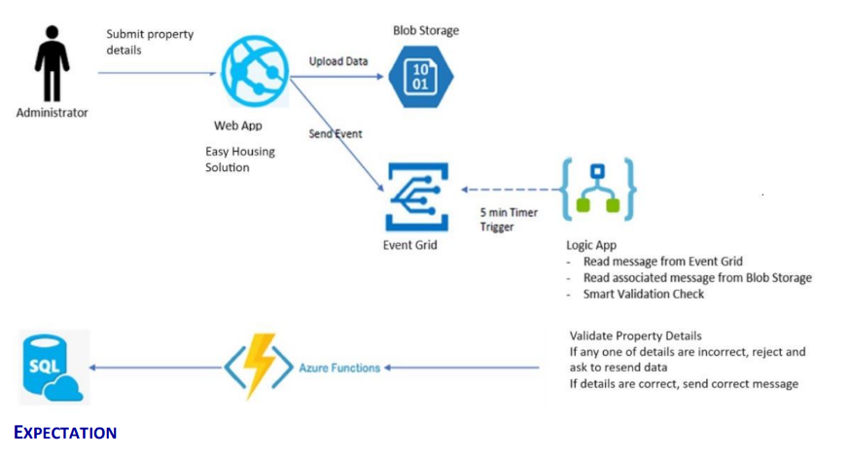
PROJECT STRUCTURE
Event-Driven Flow: Properties uploaded to Blob Storage trigger Event Grid signals.
Azure Functions: 5-minute timer triggers and data processing to SQL Server.
Logic App Integration: Smart validation checks against business rules before rejection or approval.

Slide 6






USE CASE ROLES
Admin
Owner/Seller
Buyer/Consumer
•
Verify/De-activate Property
•
Register & Add Property
•
Search & Sort by Price
•
View Property by Region
•
Upload (Max 6) Images
•
Manage Cart (Add/Delete)
•
View Property by Owner
•
Edit & View Verified Lists
•
Get Owner Contact Details

Slide 7
CORE MODULES AND APPLICATION FEATURES
Module | Description
Users | Stores login credentials and user roles
Seller | Manages property owner details
Buyer | Stores buyer profile information
Property | Holds property listings and metadata
Images | Stores and manages property images
Cart | Tracks buyer-selected properties
State | Maintains state-level location data
City | Maintains city-level location data

Slide 8
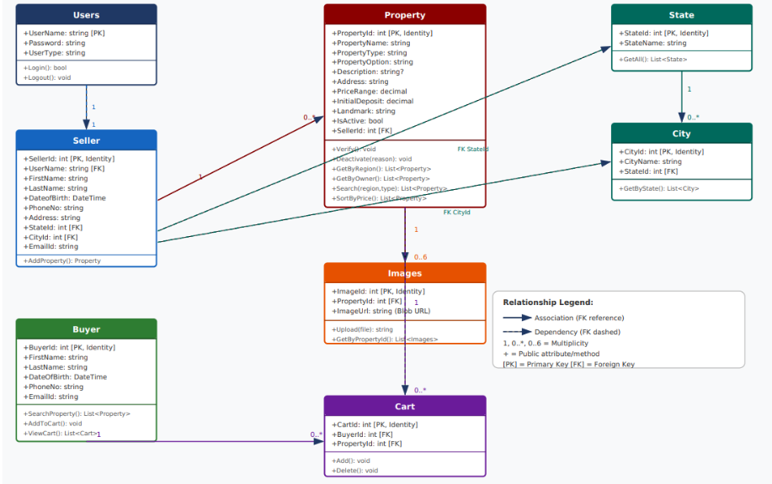
DATA SCHEMA (ER)
Entity | Primary Key | Key Attributes
Users | UserName | Password, UserType
Seller | SellerId | UserName, Phone, CityId
Property | PropertyId | Name, Type, PriceRange
Cart | CartId | BuyerId, PropertyId
Images | ImageId | PropertyId, ImageBlob

Slide 9

ADMIN CONTROLS
Property Verification
Regional Analysis
Admins hold primary control. Only verified properties are listed publicly. If deactivated, a mandatory "Reason for Deactivation" must be logged.
Ability to filter and analyze the entire housing market database by State, City, or specific Regions to ensure balanced inventory.
Automated validation via Logic Apps reduces manual verification effort.
Unified dashboard for viewing all listings by specific owners.

Slide 10






SPRINT CHALLENGES
Async Integration
Code-First EF
Smart Validation
Managing the asynchronous flow between Azure Event Grid and Function Apps for property uploads.
Handling complex migrations and foreign key constraints between the Buyer, Seller, and Property tables.
Designing Logic App workflows that accurately reject incorrect data and send appropriate notifications.

Slide 11
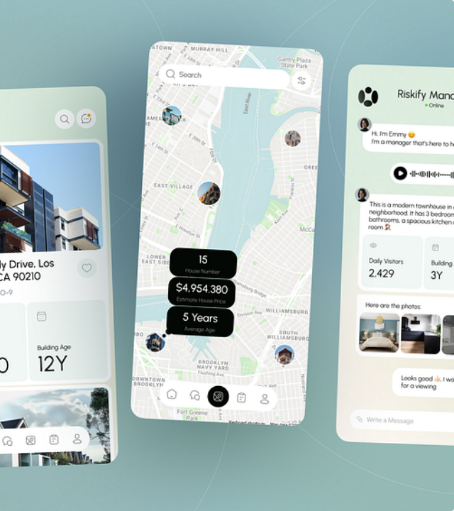
FUTURE SCOPE
AI Price Prediction: Machine learning models to suggest optimal sell/rent prices based on landmarks.
Real Time Features: Live chat B/W Buyers and Sellers and Notification System
Power BI Integration : Dashboards

Slide 12

Q&A
Thank you for your attention!
Group Project | .NET Core Azure Sprint

